Slide 1
Database Systems

Slide 2
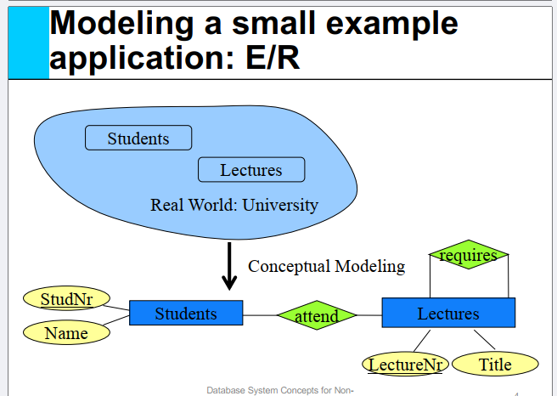

Slide 3
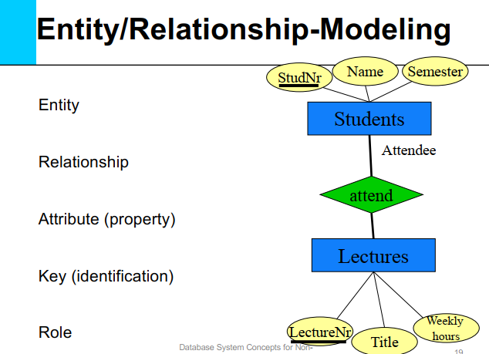

Slide 4
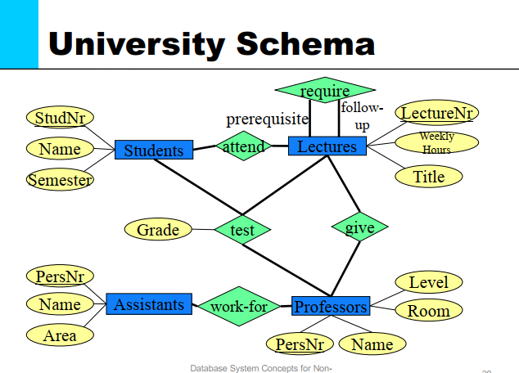

Slide 5
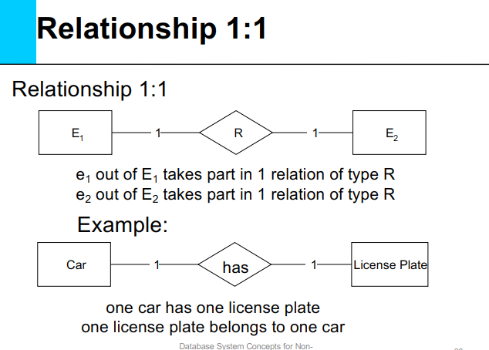

Slide 6
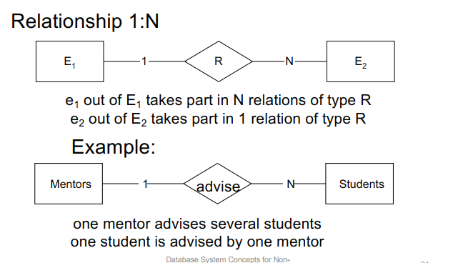

Slide 7
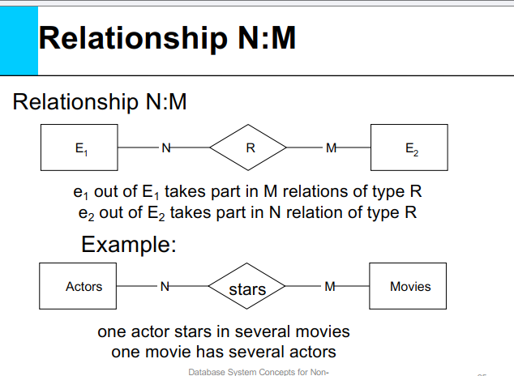

Slide 8
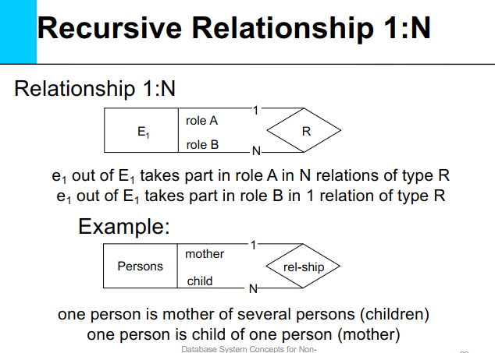

Slide 9
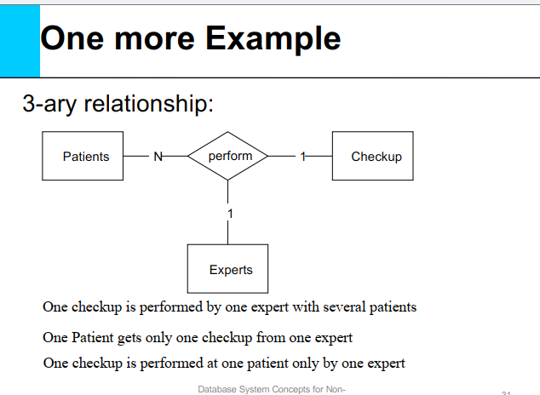

Slide 10
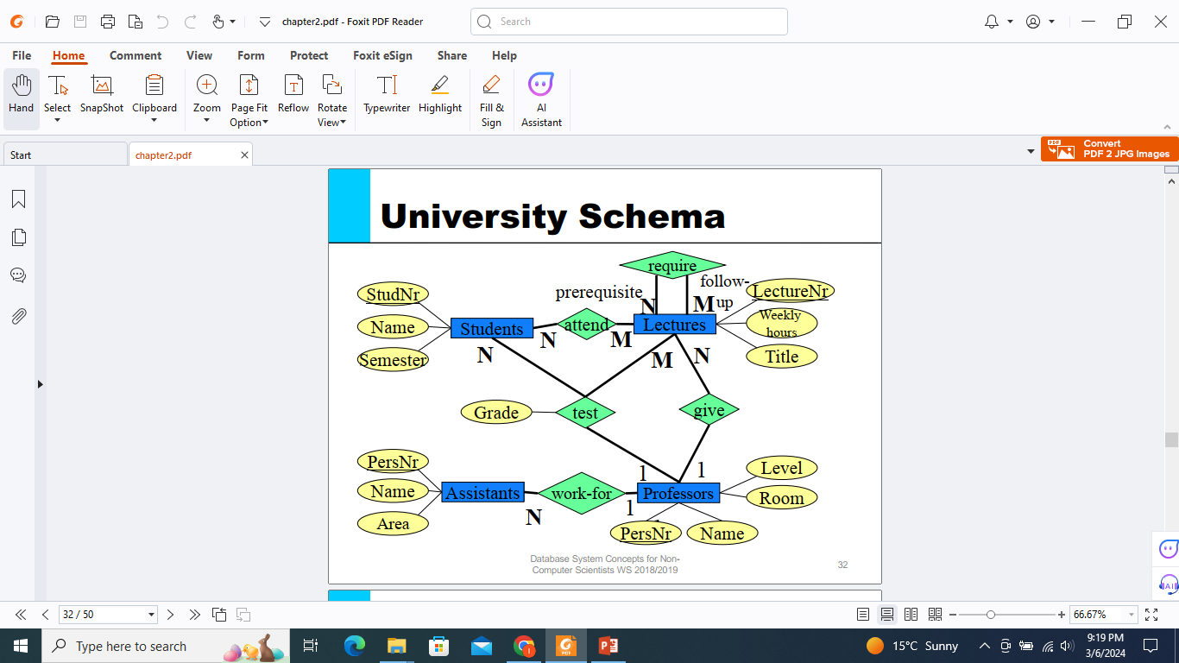

Slide 11
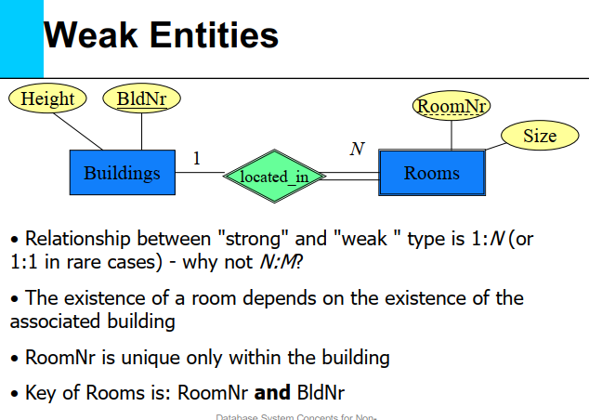

Slide 12
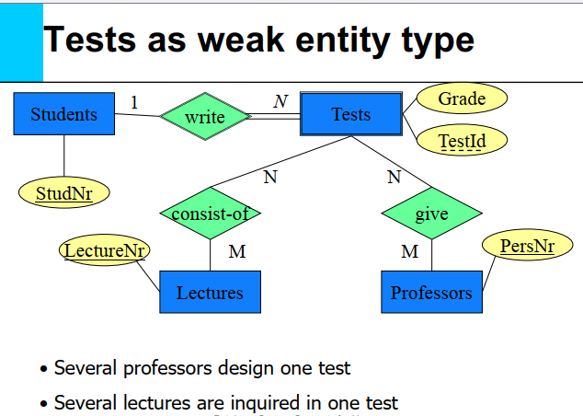

Slide 13
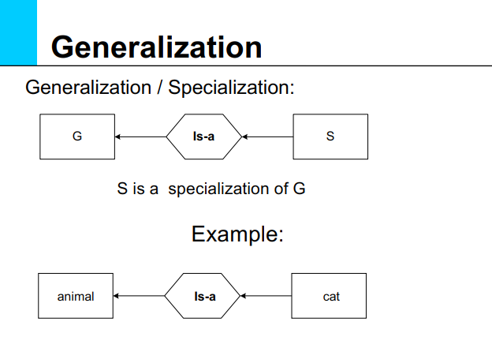

Slide 14
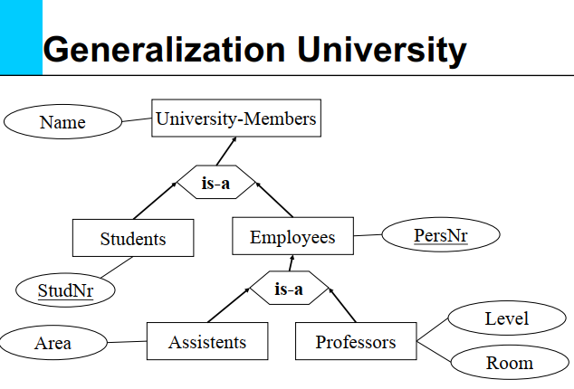
Specialization

Slide 15
Scenario to ERD: Step by Step Solution
Scenario/Case Study/Business Rules:
A University contains many Faculties. The Faculties in turn are divided into several Schools. Each School offers numerous programs and each program contains many courses. Lecturers can teach many different courses and even the same course numerous times. Courses can also be taught by many lecturers. A student is enrolled in only one program but a program can contain many students. Students can been rolled in many courses at the same time and the courses have many students enrolled.

Slide 16
Step 1: Identify Entities
A University contains many Faculties. The Faculties in turn are divided into several Schools. Each School offers numerous programs and each program contains many courses. Lecturers can teach many different courses and even the same course numerous times. Courses can also be taught by many lecturers. A student is enrolled in only one program but a program can contain many students. Students can been rolled in many courses at the same time and the courses have many students enrolled.

Slide 17
Step 2: Identify Relationships
A University contains many Faculties. The Faculties in turn are divided into several Schools. Each School offers numerous programs and each program contains many courses. Lecturers can teach many different courses and even the same course numerous times. Courses can also be taught by many lecturers. A student is enrolled in only one program but a program can contain many students. Students can been enrolled in many courses at the same time and the courses have many students enrolled.

Slide 18
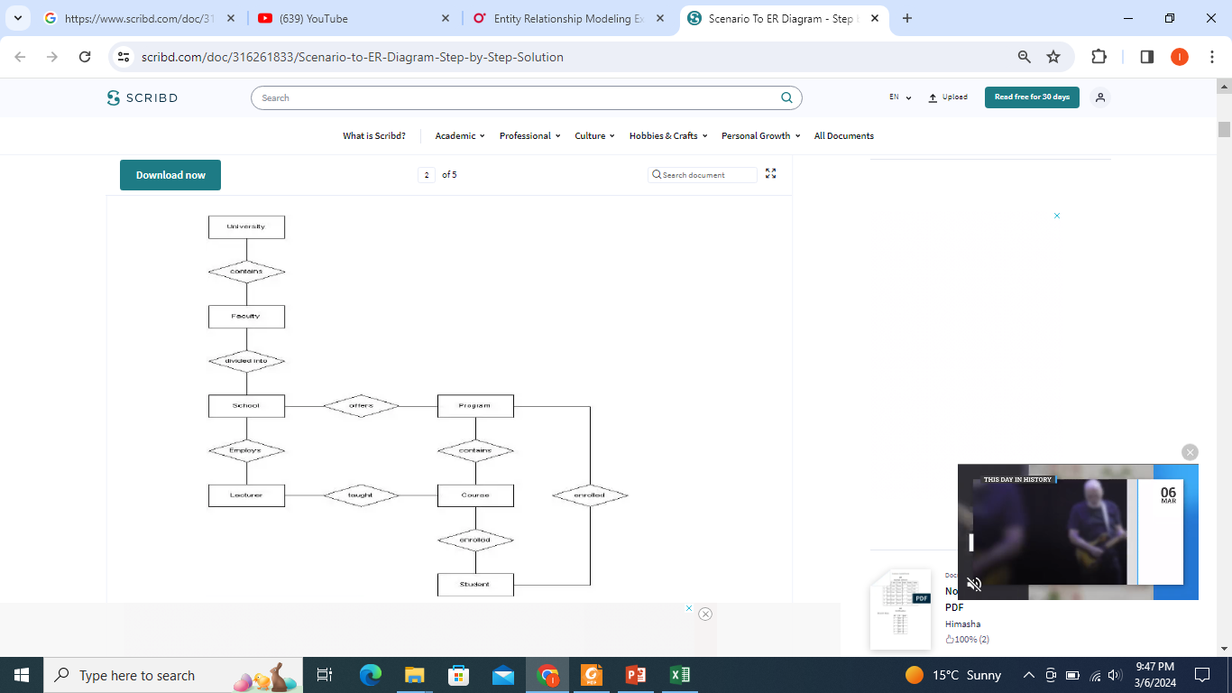
Step 3: Draw simple/rough ERD

Slide 19
Step 4: Fill in Cardinalities
The university contains many faculties
Each faculty is divided into several schools
Each school offers numerous programs
Each program contains many courses
Each school employs many lecturers
Lecturers can teach many courses
Lecturers can teach the same course many times
Courses can be taught by more than one lecturer
A student is enrolled in only one program
Students can be enrolled in many courses at the same time
Courses have many students enrolled

Slide 20
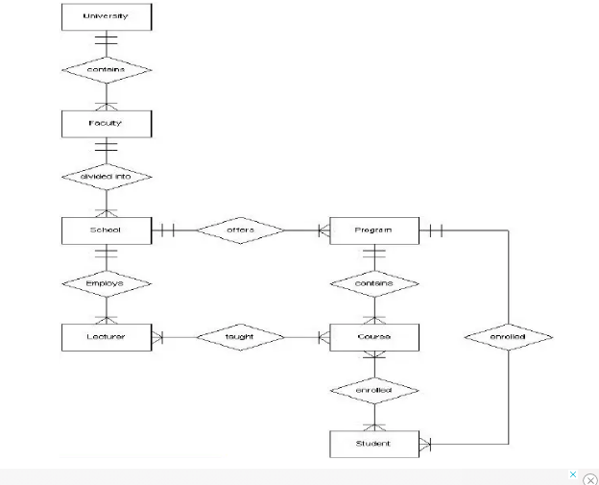
Step 5: Draw Max & Min Cardinalities on ERD

Slide 21
Step 6: Define Primary keys
  Complete the ERD by adding attributes (Oval) and Primary keys (underline attribute) according to the given criteria.
  And,
  Add weak entities, identifying relationships or associative entities according to the given scenario (if required).

Slide 22
ERD

Slide 23
Another Example

Slide 24
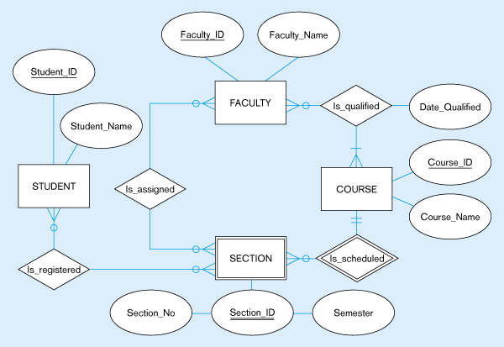
Another Example

